Slide 1
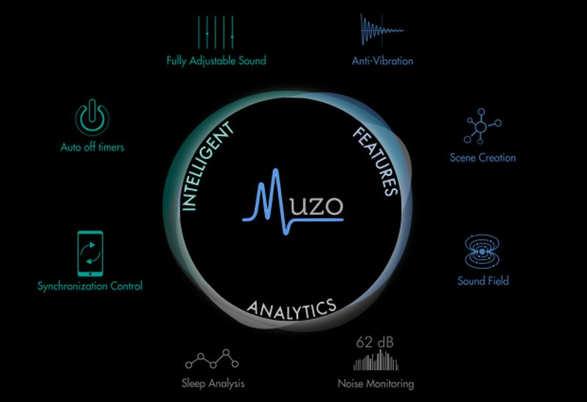
MUZO-NOISE BLOCKING GADGET

Slide 2
GROUP MEMBERS
HIFSA BASHARAT 02-235162-012
HARIS ANWER 02-235162-011

Slide 3
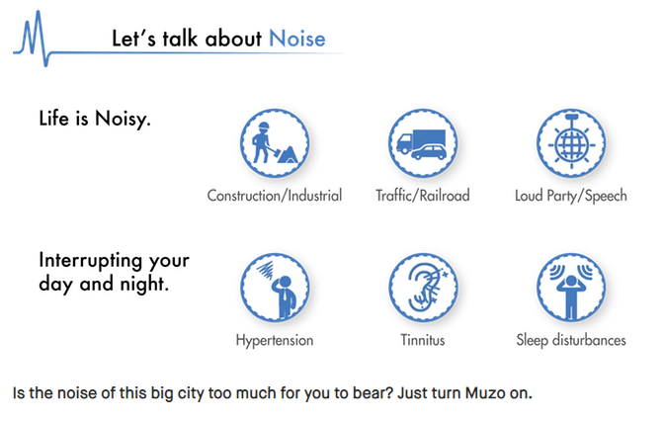
THINK FOR A SECOND

Slide 4
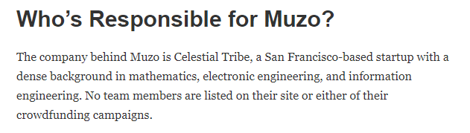
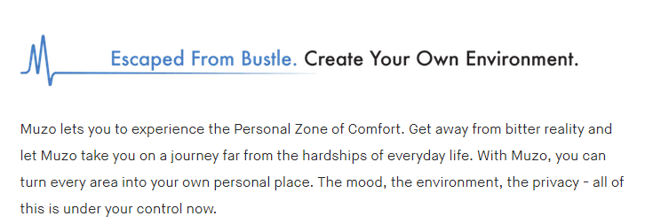
WHO IS RESPONSIBLE ?

Slide 5
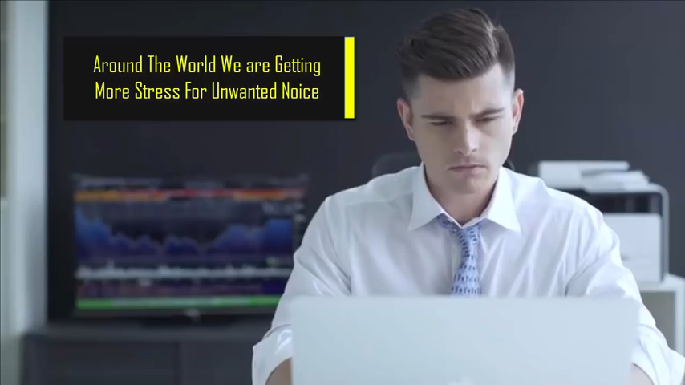
MUZO OUR PROPOSED SOLUTION

Slide 6
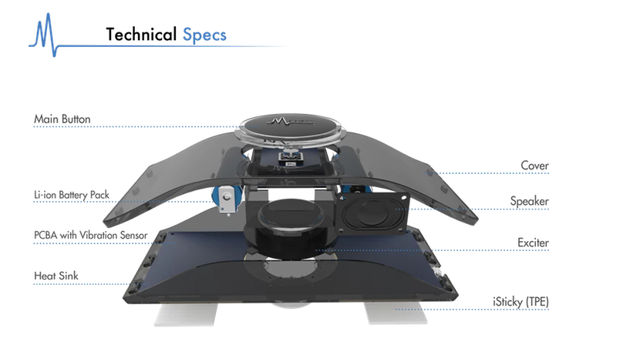
CONSTRUCTION

Slide 7
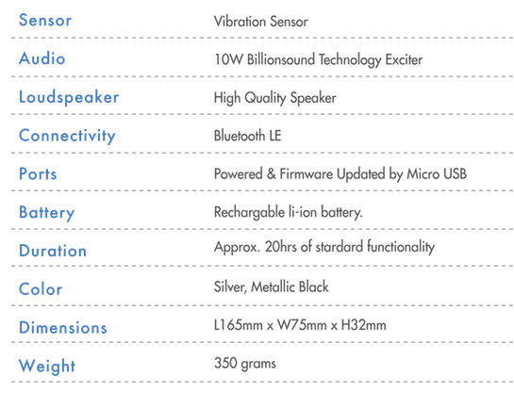
SPECIFICATIONS

Slide 8

WHAT IS EXCITER?

Slide 9
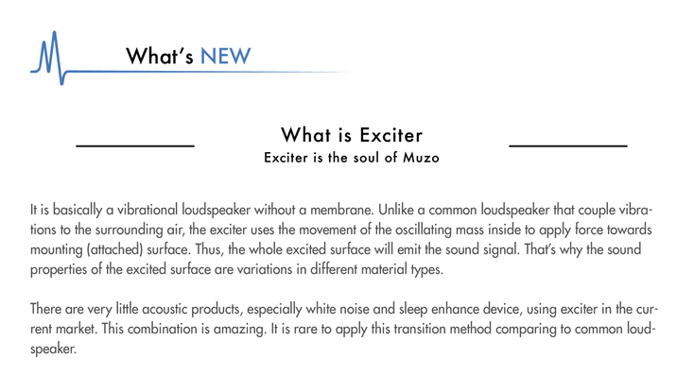
WHAT IS EXCITER?

Slide 10
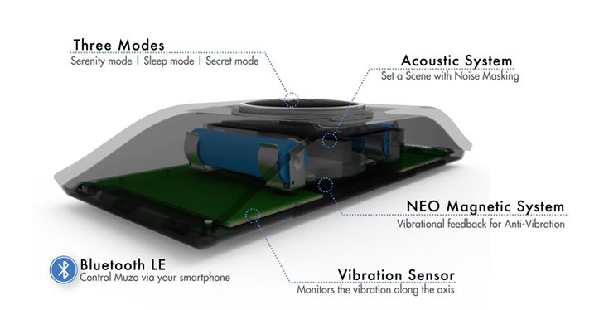
WORKING

Slide 11
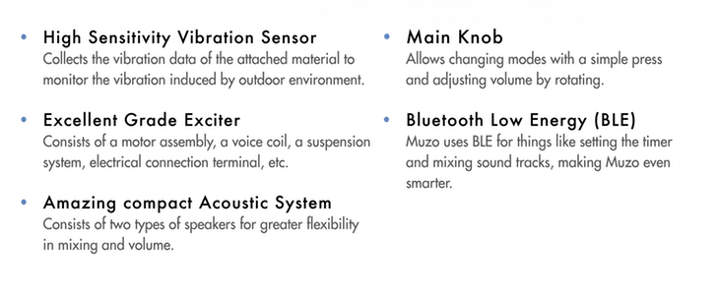
WORKING

Slide 12
STATE OF THE ART VIBRATION MONITORING SYSTEM
Muzo is the first acoustic device that applies Anti-Vibration Technology for smooth surface.
This Exclusive Technology prevents objects from vibrating to minimize any unwanted disturbances nearby.
Besides, Muzo utilizes Billion sound Technology (Powered by BST) to generate dynamic realistic sounds.

Slide 13
STATE OF THE ART VIBRATION MONITORING SYSTEM
These vivid sounds set the scene and drown out intrusive noises.
Whether you wish to enjoy a piece of serenity or to become engulfed in the tranquil sounds of nature, Muzo will be there for you.

Slide 14
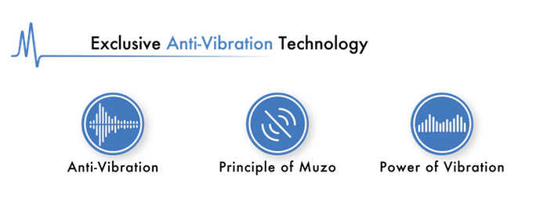
EXCLUSIVE ANTI VIBRATION

Slide 15
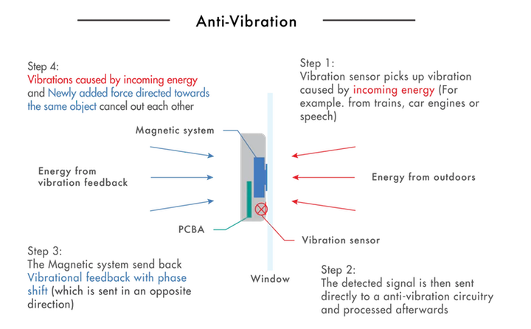

Slide 16
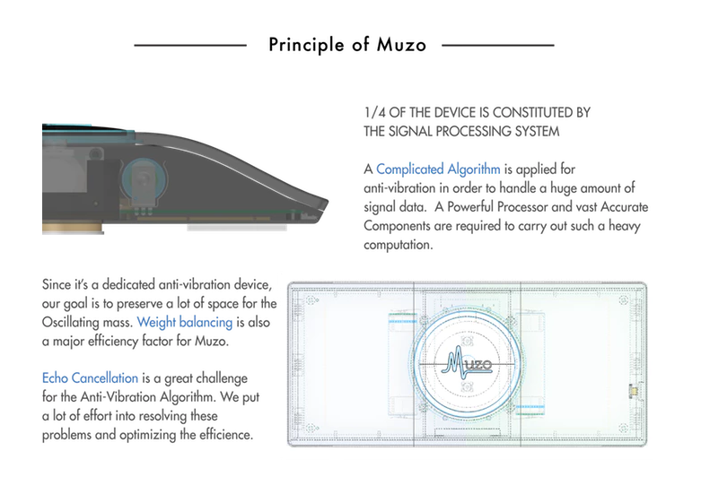

Slide 17
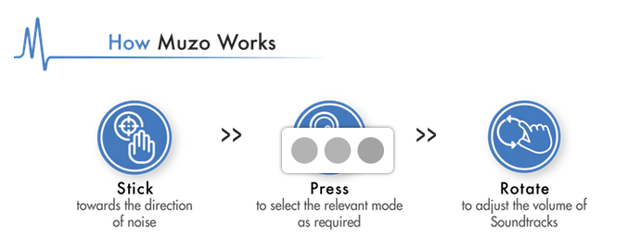
HOW TO USE

Slide 18
BUSSINESS CANVAS
MODEL

Slide 19
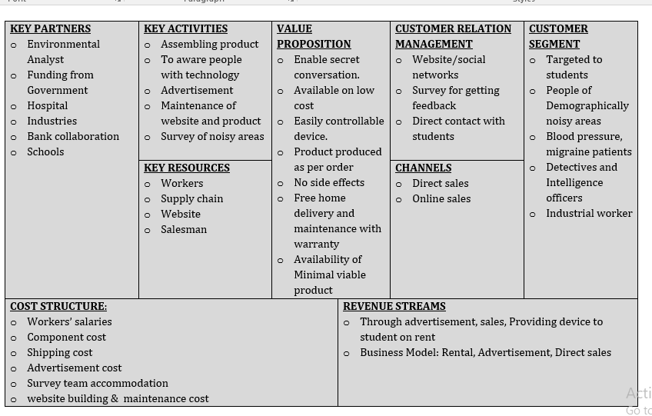

Slide 20

KEY PARTNERS
Friends, Family
Funding from Government
Hospital
Industries
Bank collaboration
Schools
Advance Payments
Companies which makes house hold products

Slide 21

KEY ACTIVITIES
Assembling product
Buying spare parts, Testing
To aware people with technology
Advertisement on sites, bills as well
Maintenance of website and product
Affiliation with Corrier services
Cost Analysis, Product Delivery, Gathering Orders

Slide 22

KEY RESOURCSE
Workers (We will be..)
Supply chain
Website
Physical Store

Slide 23

VALUE PROPOSITION
User Friendly product
Available on reasonable cost
Product produced as per order
No side effects, Available on Rent
Free home delivery and maintenance with warranty
1st we will provide Demo
Default products exchangeable
75% money will be reimburse if Customer not satisfied but within 10 days of purchasing.
Market price $116, Our cost will be $100 & price will be set to $110 ,Our revenue would be $10 on each product

Slide 24

CUSTOMER RELATIONSHIP
Website/social networks
Survey for getting feedback after 10 days of buying our product
Direct contact with students

Slide 25
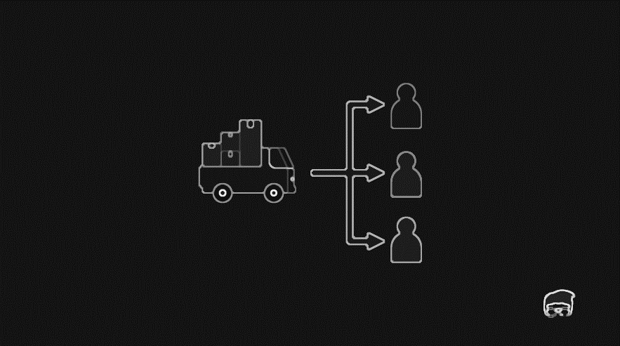
CHANNELS
Direct sales
Karachi Physical Store
Online Sales
Through website named as hkOm.com.pk

Slide 26

COST STRUCTURE
Workers’ salaries(profit will be distributed among 4 of us)
Component cost
Shipping cost
Advertisement cost
Survey team accommodation

Slide 27

CUSTOMER SEGMENT
Targeted to students
People of Demographically noisy areas
Blood pressure, migraine patients
Detectives and Intelligence officers

Slide 28
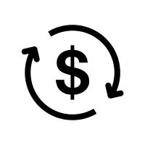
REVENUE STREAM
Through advertisement, sales, Providing device to student on rent
Business Model: Rental, Advertisement, Direct sales

Slide 29
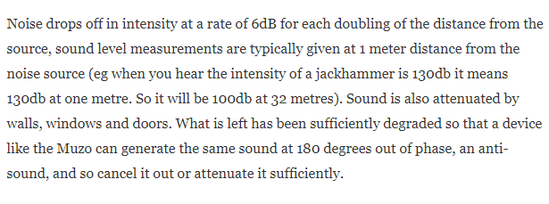
THROUGH BACK TO MUZO

Slide 30
CONCLUSION
It would be Clone Market.
Our estimated revenue would be $16 per product.
According to our business model canvas we will cope up with our expenses.

Slide 31


